Slide 1
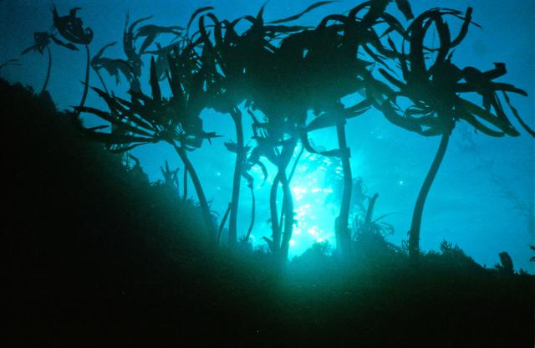
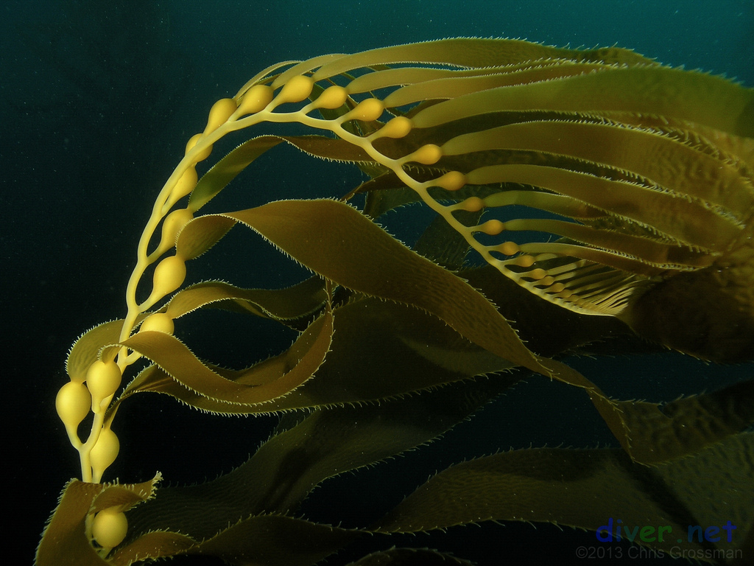
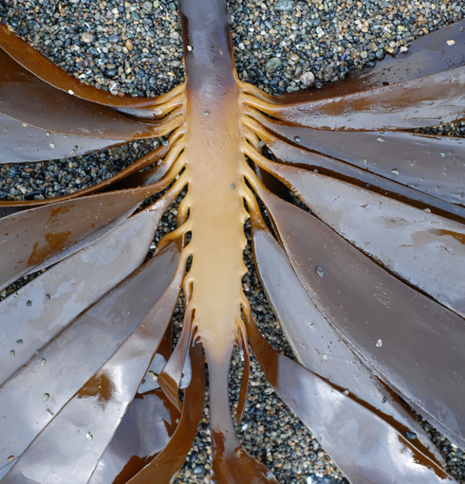
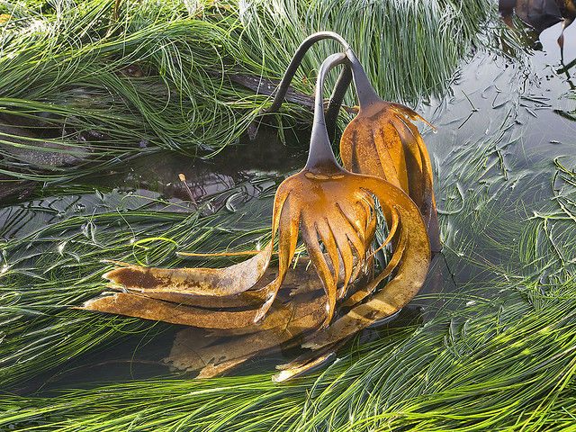
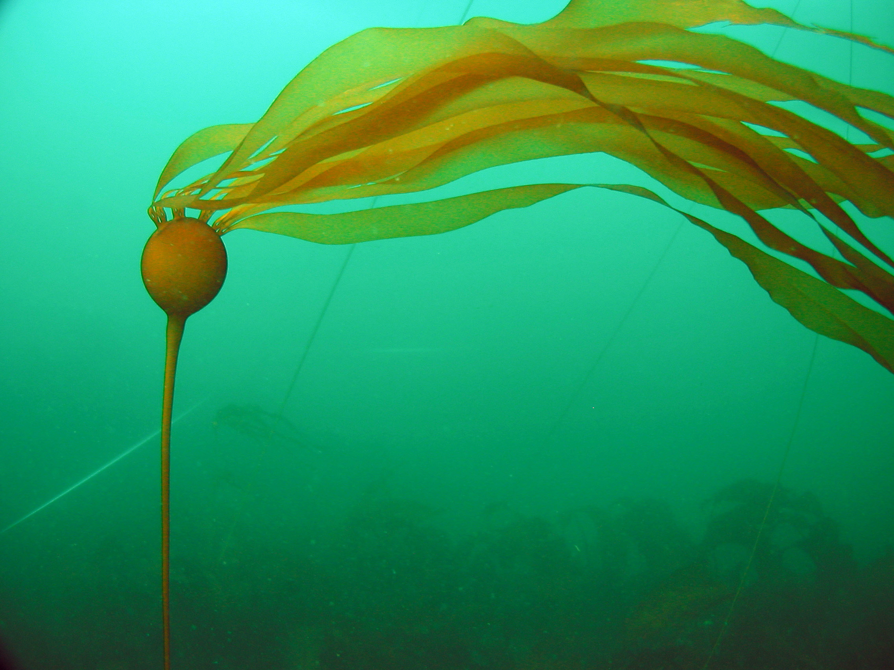
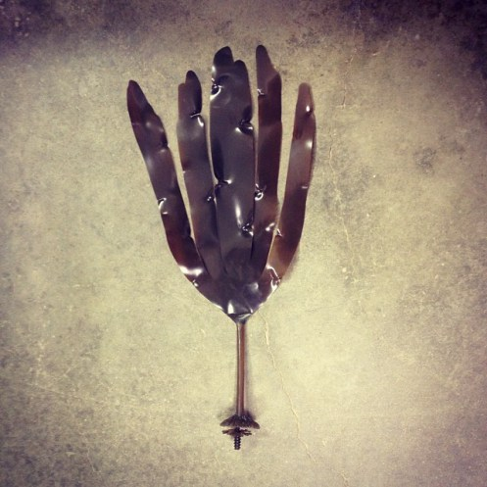
Brown Algae – Stipe surveys
Pterygophora californica
Macrocystis pyrifera
Laminaria setchellii
Nereocystis luetkeana

Slide 2
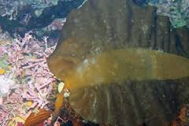
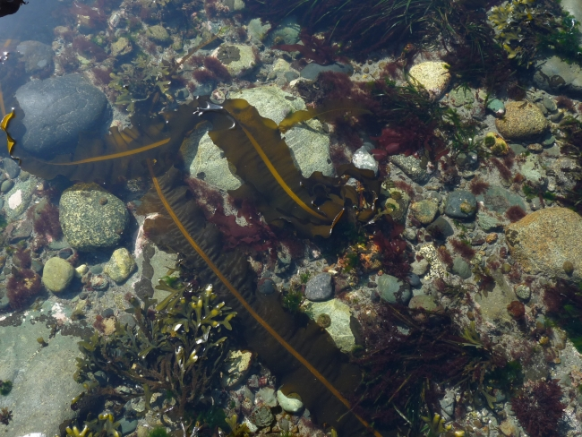
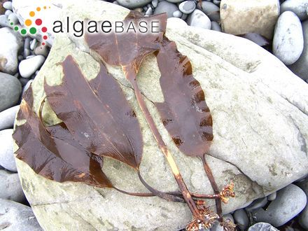
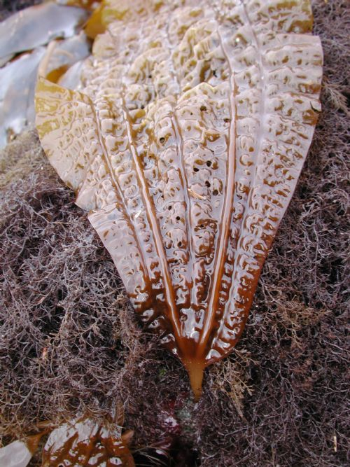
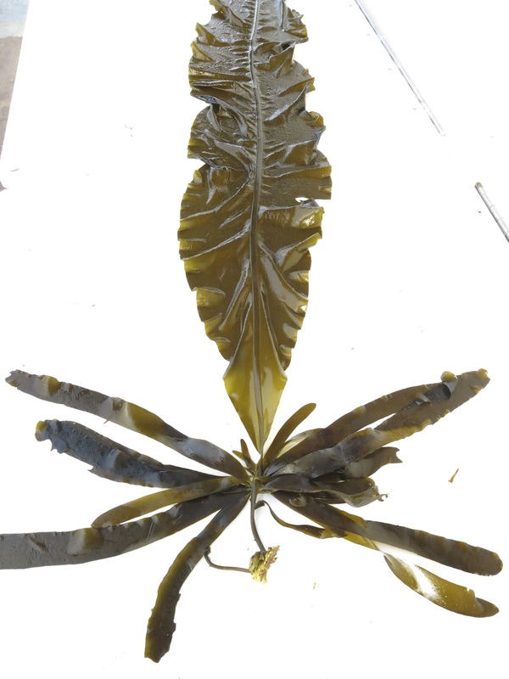
Brown Algae – Stipe surveys
Pleurophycus gardneri (broad-rib kelp)
Alaria marginata (winged kelp)
Costaria costata (5 rib)

Slide 3
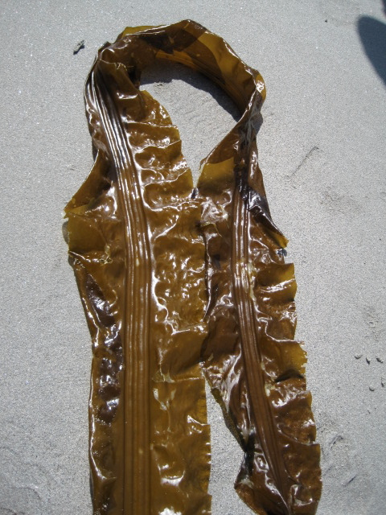
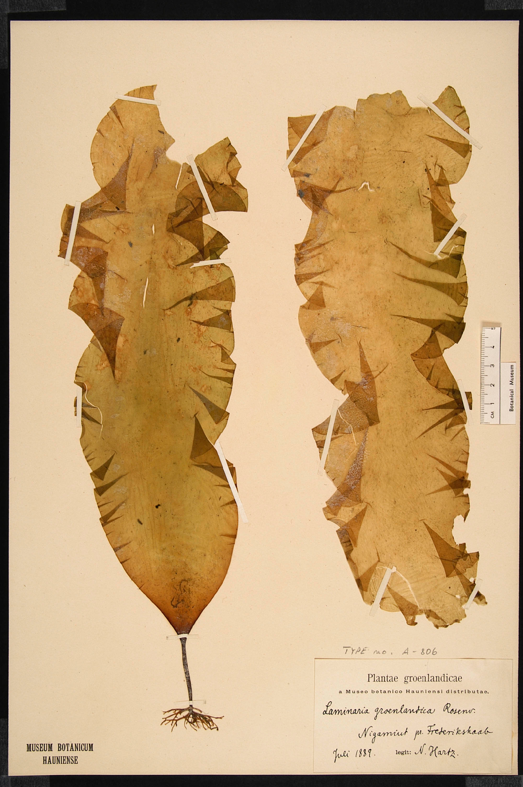
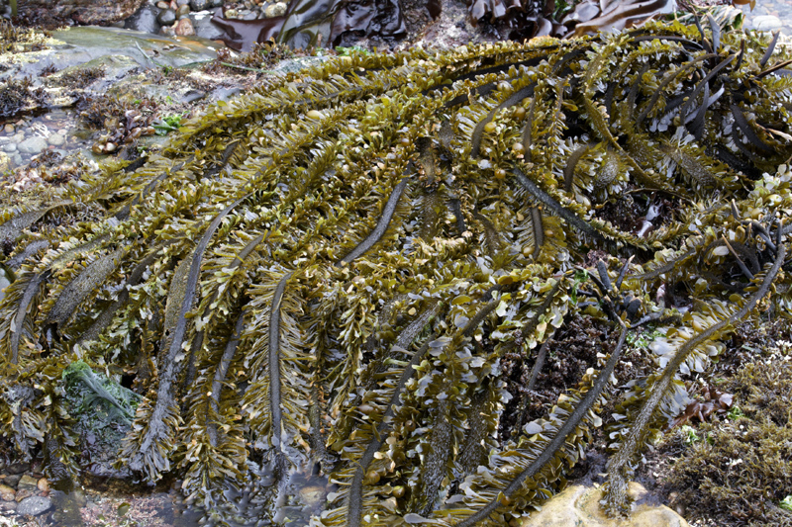
Brown Algae - Stipes
Cymathere triplicata –
3 rib kelp
Saccharina groenlandica (formerly Laminaria?)
Egregia menziesii – feather boa

Slide 4
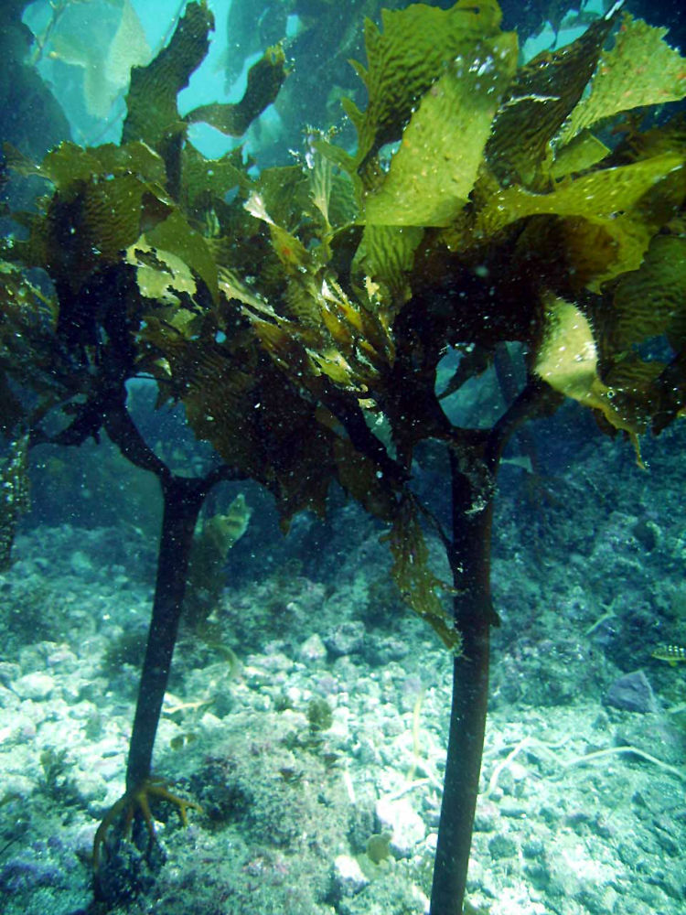
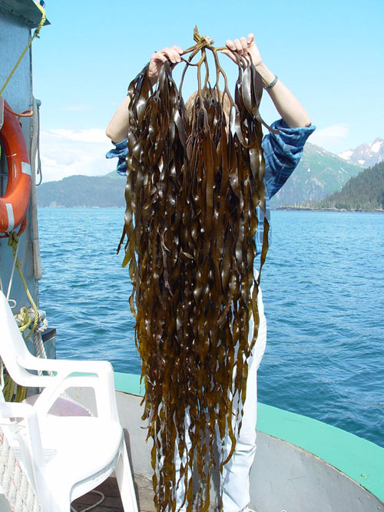
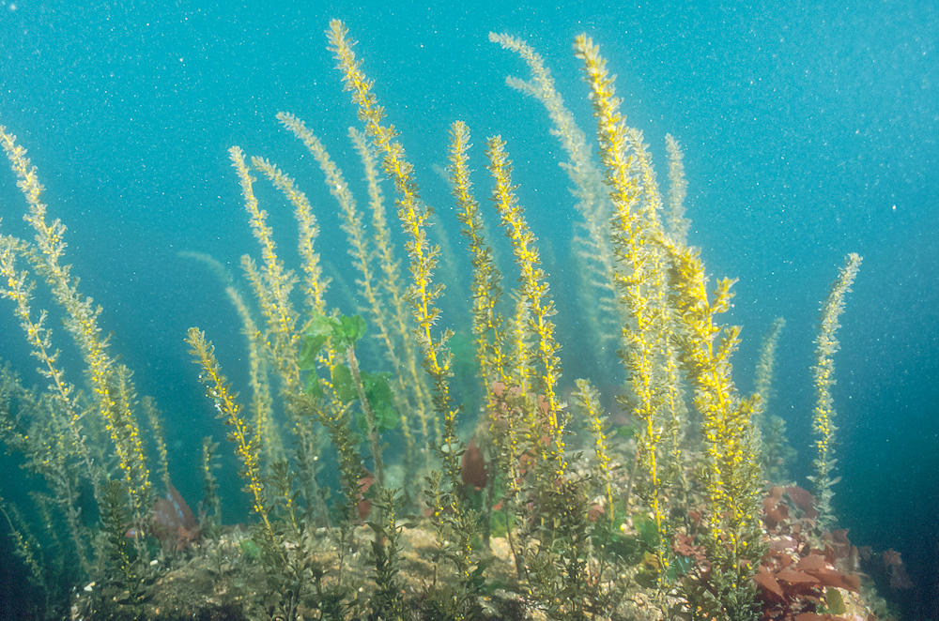
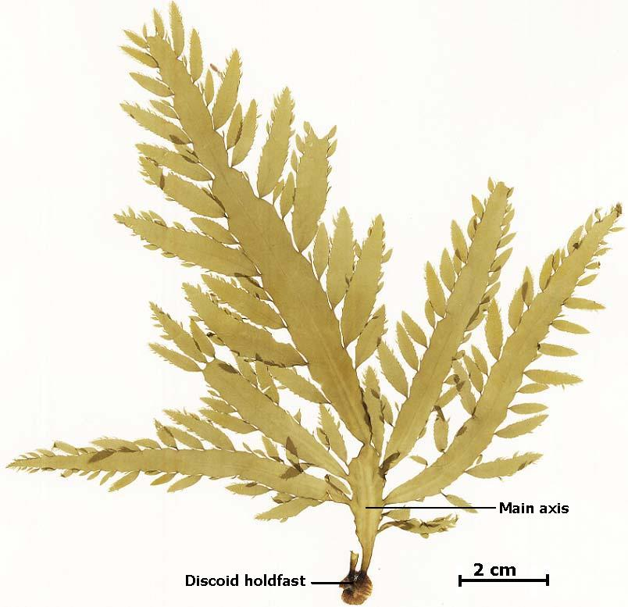
Other Brown Algae
Eisenia arborea – sea palm
Lessoniopsis littoralis
Not seen in 2015 surveys (top)
Sargassum muticum
Desmerestia ligulata
No stipe / <30 cm length (bottom)

Slide 5
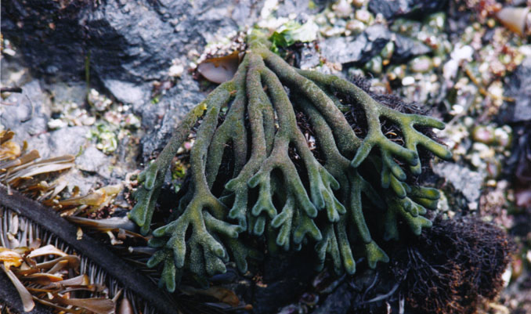
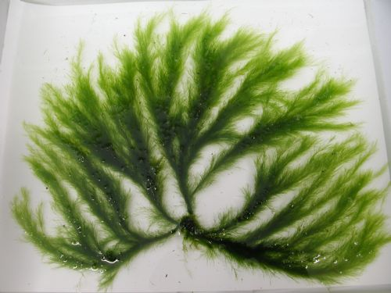
Green Algae
Codium fragile
(Codium sp. also comes in pin-cushion form)
Acrosiphonia coalita

Slide 6
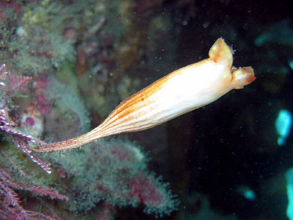
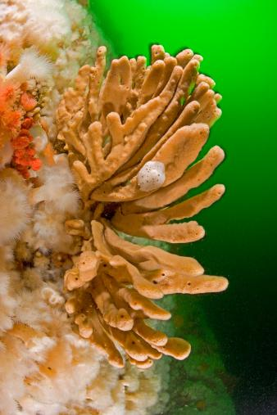
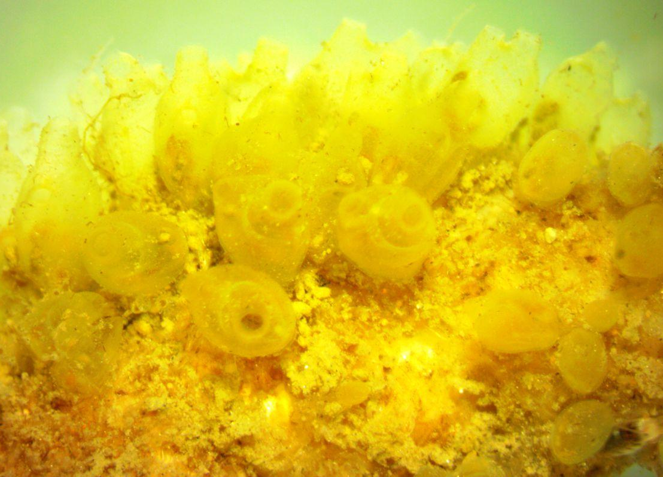
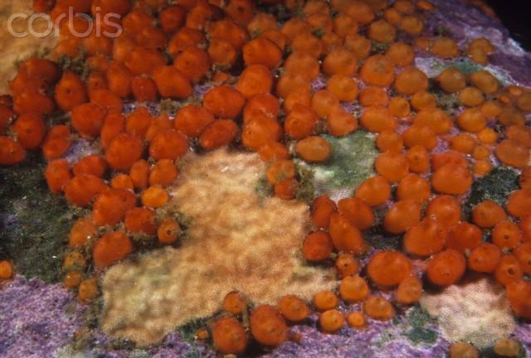
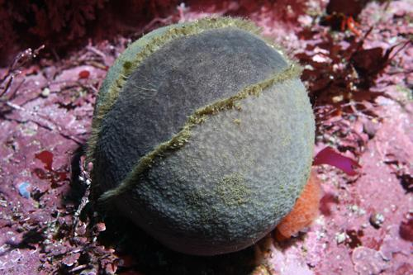
Tunicates
Sponges
Styela montereyensis
(Monterey stalked tunicate)
Isodictya quatsinoensis
(orange finger sponge)
Perophora annectens
(sea grapes, yellow social tunicate)
Metandrocarpa taylori
(Taylor’s social tunicate)
Craniella arb
(grey puffball sponge)

Slide 7
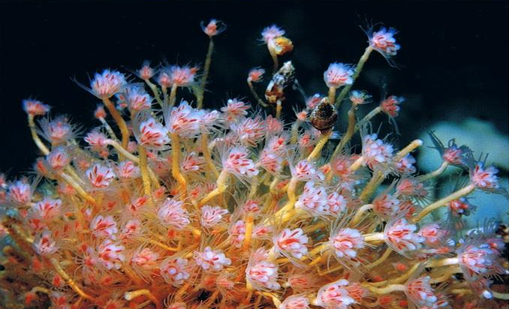
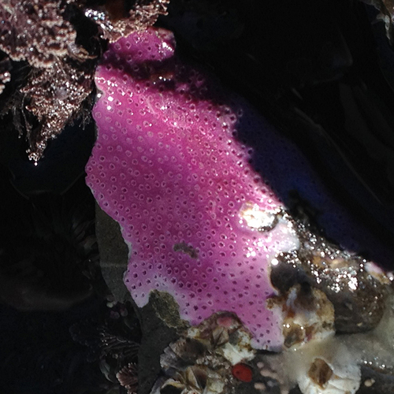
Hydrozoans
Ectopleura crocea
(pink-mouth hydroid)
Stylantheca papillosa

Slide 8
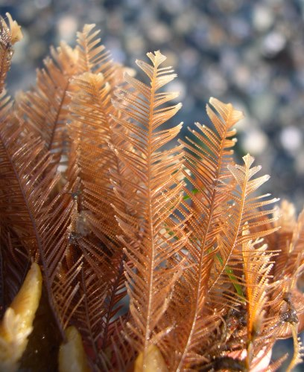
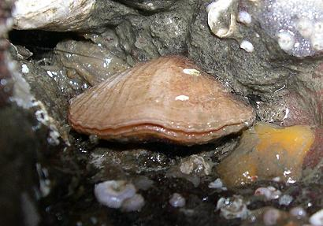
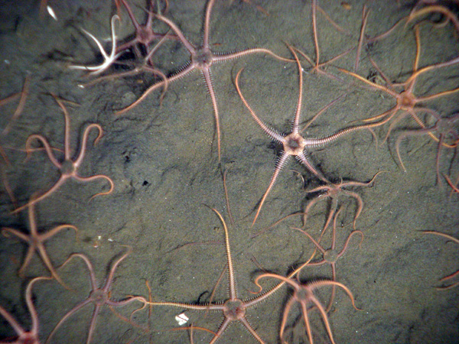
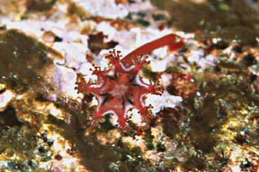
Bryozoans
Ostrich plume hydroid:
Aglaophenia sp.
Brachiopods
Lampshell:
Terebratalia transversa
Ophiuroid
Brittle star:
Ophiura sarsi
Scyphozoa
Thaumatoscyphus (=Manania)

Slide 9
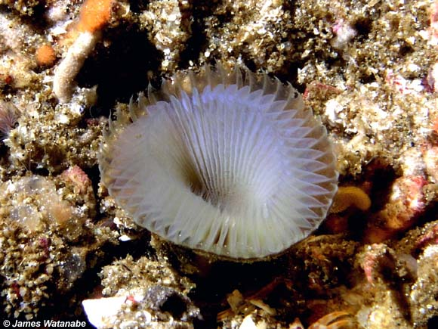
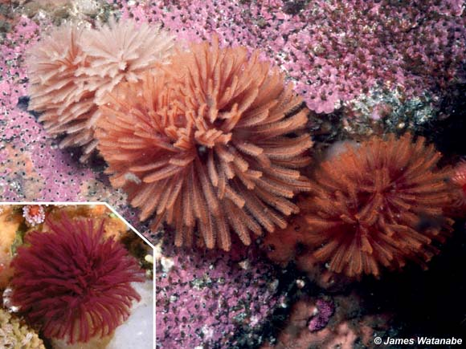
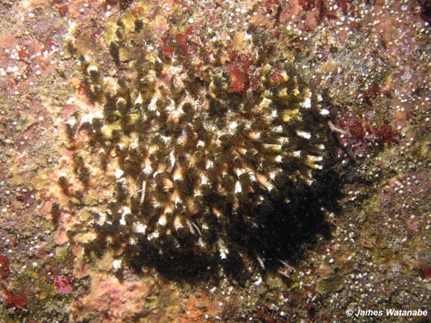
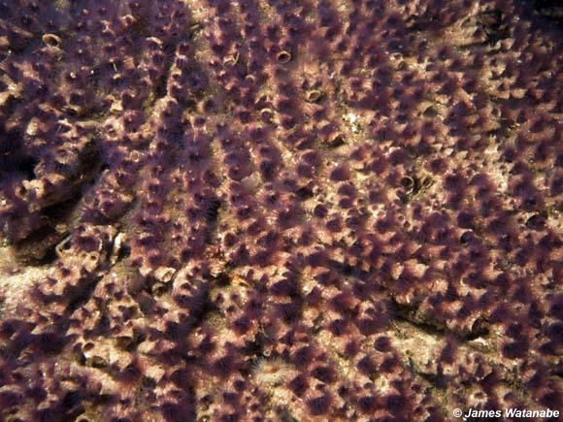
Polychaeta (http://seanet.stanford.edu/Polychaeta/)
Featherduster worm:Eudistylia polymorpha
Myxicola infundibulum
Phragmatopoma californica
Dodecaceria fewkesi

Slide 10
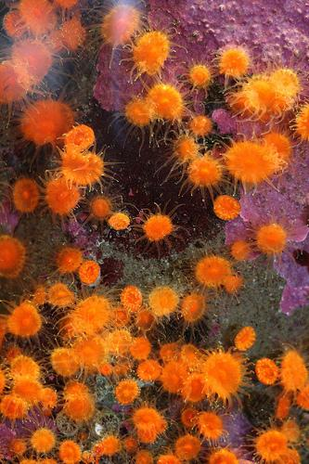
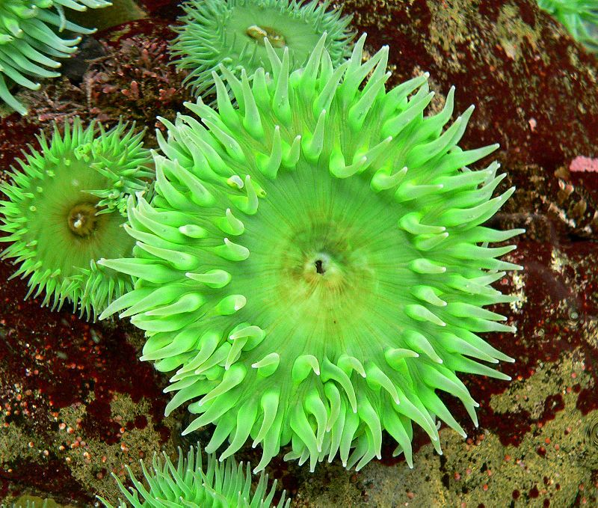
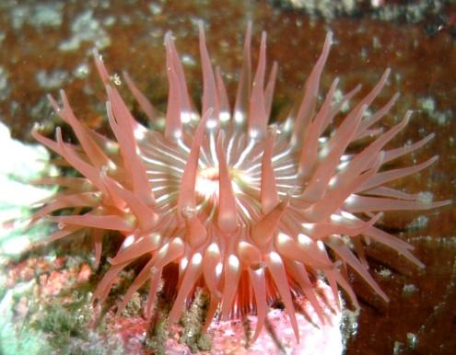
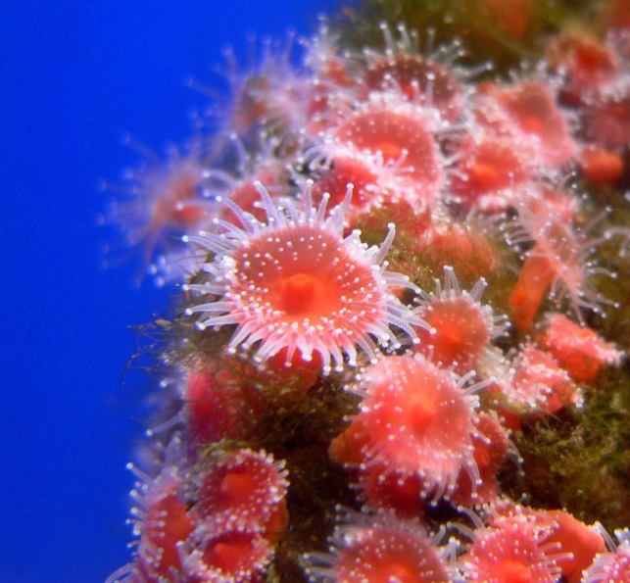
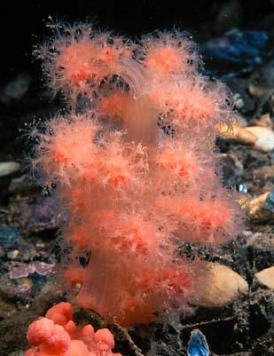
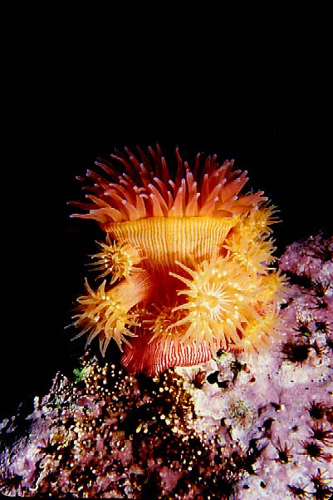
Cnidarians
Balanophyllia elegans (orange cup coral)
Anthopleura elegantissima (aggregating anemone)
Anthopleura xanthogrammica (giant green anemone)
Epiactis prolifera (brooding anemone)
Corynactis californica (strawberry anemone)
Gersemia rubiformis
(sea strawberry, soft coral)

Slide 11
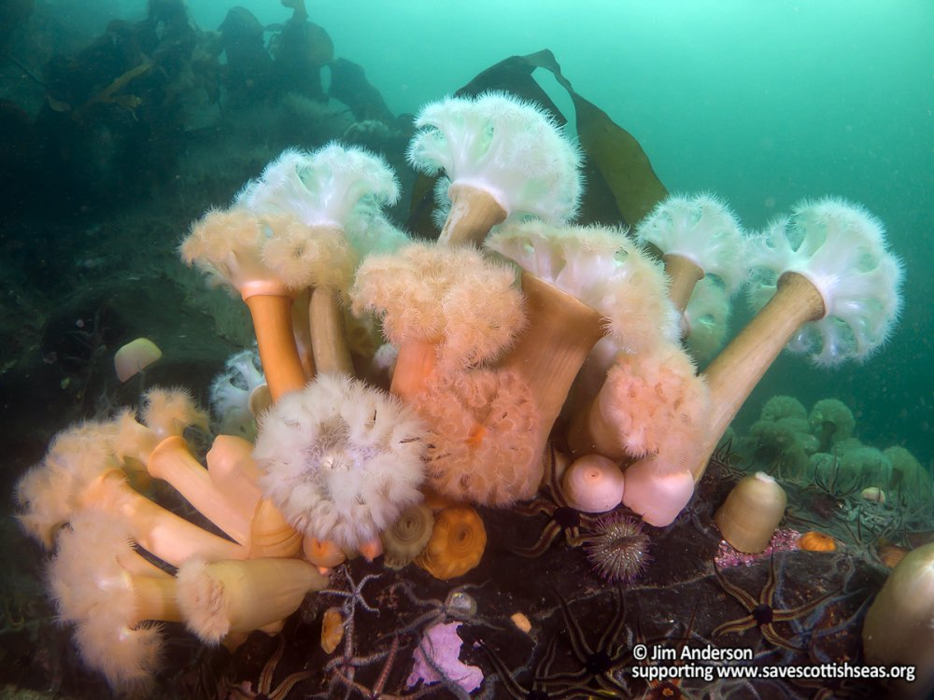
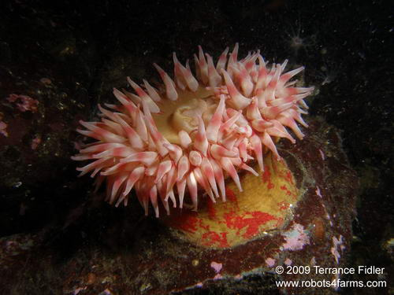
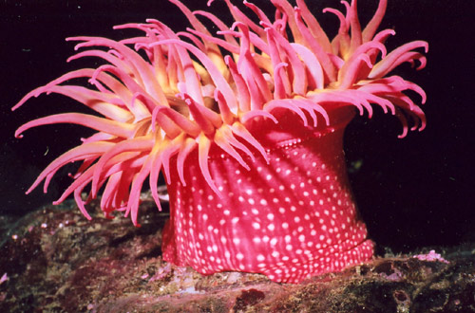
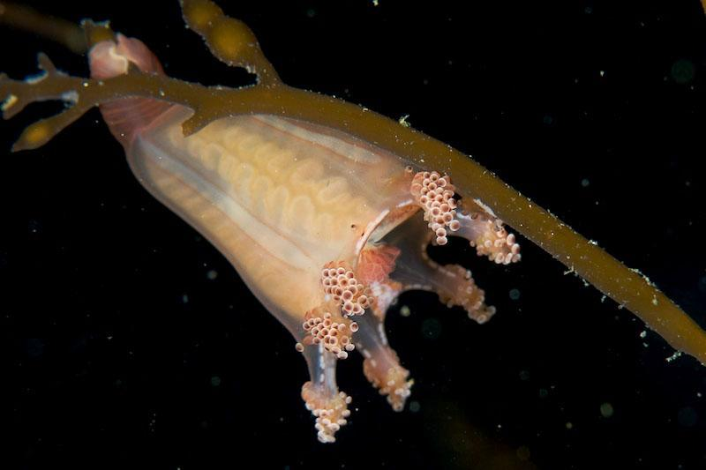
Cnidarians
Metridium senile (plumose anemone)
Urticina crassicornis (mottled anemone)
Scyphozoans
Manania hexaradiata
(stauromedusan, stalked jelly)
Urticina lofotensis
(white-spotted rose anemone)

Slide 12
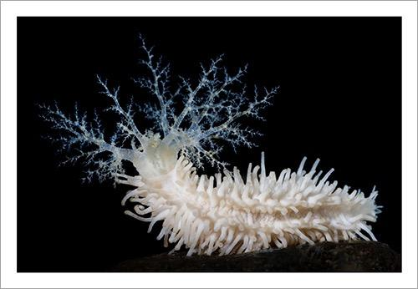
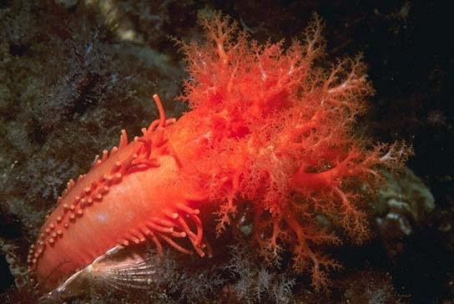
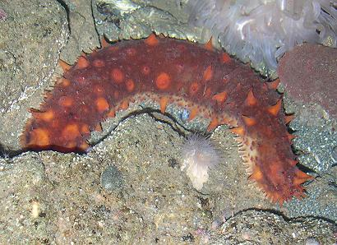
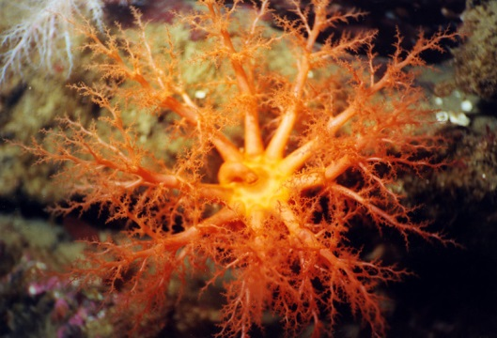
Sea Cucumbers
Eupentacta quinquesemita
(stiff-footed cucumber)
Cucumaria miniata
(orange sea cucumber)
Parastichopus californicus
(giant sea cucumber)

Slide 13
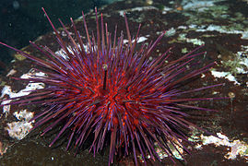



Urchins
Mesocentrotus franciscanus
(red sea urchin)
Mesocentrotus purpuratus
(purple sea urchin)
Mesocentrotus droebachiensis
(green sea urchin)

Slide 14







Echinoderms
Evasterias troschelii
(mottled star)
Dermasterias imbricata
(leather star)
Henricia leviuscula
(blood star)
Leptasterias hexactis
(six-rayed star)
Pisaster ochraceus
(ochre star)

Slide 15





Echinoderms
Orthasterias koehleri
(red-banded or rainbow star)
Patiria miniata
(bat star)
Solaster dawsoni
(morning sun star)
Pycnopodia helianthoides
(sun star)
Solaster stimpsoni
(striped sun star)

Slide 16


Bivalvia
Rock scallop: Crassodoma gigantea
Nemertea
Nemertean worm

Slide 17






Gastropods
Tegula brunnea
(Brown Top Shell)
Amphissa columbiana
(Wrinkled Dove Snail)
Calliostoma ligatum
(Blue Top Snail)
Ceratostoma foliatum
(Leafy Hornmouth)
Fusitron oregonensis
(Hairy triton)
Ocenebra lurida
(Lurid Rock Snail)

Slide 18




Chitons
Placiphorella velata
(Veiled Chiton)
Cryptochiton stelleri
(Giant Gumboot Chiton)
Tonicella lineata
(Lined Chiton)
Mopalia lignosa
(Woody Chiton)

Slide 19




Limpets
Acmaea mitra
(Whitecap Limpet)
Diodora aspera
(Rough keyhole limpet)
Collisella instabilis
(Unstable Limpet)

Slide 20




Nudibranchs
Montereina nobilis
(Pacific sea lemon, spots between but not on tubercules)
Janolus barbarensis
Doris montereyensis
(Monterey sea lemon, spots on tubercules, gills darker than body)
Doris odhneri
(white knight dorid, low tubercules)

Slide 21




Nudibranchs
Dirona albolineata
(white-lined dirona)
Tritonia festiva
(diamond back tritonia)
Triophe catalinae
(sea clown triophe)
Limacia cockerelli
(orange-clubbed nudibranch)

Slide 22









Decapod Crustacea (Crabs)
Pugettia gracilis
Scyra acutifrans
Pugettia producta
Cancer oregonensis
Cryptolithodes sitchensis
Pagurus hirsutiusculus
Mimulus foliatus

Slide 23





Other Crustaceans
Pandalus danae
Amphipod:
Amphithoe plumulosa
Isopod: Idotea resecata
Barnacle: Balanus sp.

Slide 24







Fishes
Chirolophis nugator
(mosshead warbonnet)
Gibbonsia spp.
(kelpfish)
Rimicola muscarum
(kelp clingfish)
Rhacochilus vacca
(pile perch)
Embiotoca lateralis
(striped surfperch)
Rhinogobiops nicholsii
(black-eyed goby)
Gobiesox maeandricus
(Northern clingfish)

Slide 25





Sculpins
Artedius harringtoni
(scalyhead sculpin)
Jordania zonope
(longfin sculpin)
Asemichthys taylori
(spinynose sculpin)
Hemilepidotus hemilepidotus
(red Irish lord)
Scorpaenichthys marmoratus
(cabezon)

Slide 26





Greenlings
Ophiodon elongatus
(lingcod)
Hexagrammos decagrammus
(kelp greenling - male)
(female)
Oxylebius pictus
(painted greenling)
Hexagrammos stelleri
(whitespotted greenling)

Slide 27







Rockfishes
Sebastes auriculatus
(brown)
Sebastes melanops
(black)
Sebastes flavidus
(yellowtail)
Sebastes caurinus
(copper)
Sebastes mystinus
(blue)
Sebastes nebulosus
(china)
Sebastes emphaeus
(Puget Sound)

Slide 28
Species List – Table 4; Kvitek 1987
Brachiopods
Terebratalia transversa r
Bryozoans
Aglaoephenia spp. p
Cnidarians
Anthozoans
Anthopleura elegantissima p
Anthopleura xanthogrammica c
Balanophyllia elegans c
Corynactis californica r
Epiactus proliferata p
Gersemia rubiformis p
Metridium senile r
Urticina crassicornis p
Urticina lofotensis r
r=rare (<1/dive), p=present (1-5/dive), c=common (5-50/dive), a=abundant (50-100/dive), va=>100/dive
Scyphozoans
Thaumatoscyphus hexaradiatus p
Crustaceans
Decapoda
Cancer oregonensis c
Cryptolithodes sp. r
Scyra acutifrons p-c
Mimulus foliatus r
Pagurus sp. c
Pandalus sp. r
Other
Balanus sp. p
Amphithoe sp. r
Idotea resecata r

Slide 29
Species List – Table 4; Kvitek 1987
Echinoderms
Dermasterias imbricata p
Evasterias troschelii c
Henricia leviuscula c
Leptasterias hexactis c
Orthasterias koehleri r
Patiria miniata r
Pisaster ochraceas p
Pycnopodia helianthoides p
Solaster dawsoni r
Solaster stimpsoni p
Urchins
Strongylocentrotus drobachiensis
Strongylocentrotus franciscanus
Strongylocentrotus purpuratus
Sea Cucumbers
Cucumaria miniata
Eupentacta quinquesemila
Stichopus californicus
Ophiuroids
Hydrozoans
Allepora porphyra
Tubularia crocea

Slide 30
Species List – Table 4; Kvitek 1987
Gastropods
Amphissa columbiana p
Calliostoma ligatum c
Ceratostoma foliatum c
Crepidula adunca p
Ocenebra lurida p
Opalia chacei p
Searlesia dira r
Tegula brunnea p
Chitons
Cryptochiton stelleri p
Mopalia lignosa p-c
Placiphorella velata p
Tonicella lineata p
Limpets
Acmaea mitra c
Colisella instabilis c
Diodora aspera c
Nudibranchs
Anisodoris nobilis p
Antiopella barbarensis p
Archidoris montereyensis c
Archidoris odhneri p
Dirona albolineata p
Laila cockerelli p
Triophe catalinae c
Tritonia festiva p

Slide 31
Species List – Table 4; Kvitek 1987
Bivalves
Hinnites giganteus p
(Crassodoma gigantea)
Nemerteans spp. p
Polychaetes
Dodecaceria fewkesi p
Eudistylia spp. p
Myxicola infundibulum p
Phragmatopoma californica p
Sponges
Tetilla arb p
Isodictya quatsinoensis p
Tunicates
Styela montereyensis a
Perophora annectens p
Metanfrocarpa taylori p
Fishes
Damalichthys vacca r
Embiotica lateralis p
Gibbonsia spp. r
Gobieosox spp. r
Hexagrammos decagrammus c
Ophiodon elongatus p
Oxylebius pictus r
Scorpaenichthys marmoratus p
Sebastes auriculatus r
S. caurinus r
S. melanops c
S. nebulosus p

